Slide 1
ASP.NET Core
OT001
Ivan Porta
Senior .NET Developer
@GTRekter

Slide 2

About me
Ivan Porta – Senior DevOps Engineer @ Techedge Group S.p.A
DevOps Engineer and Developer with experience developing web enterprise application using .NET, Docker, Kubernetes and more. Some of the companies I have worked on in the past years include Barclays Bank, Lavazza, ENI and Pirelli.

Slide 3
Agenda
What is .NET?
The code’s journey in .NET
What is ASP.NET?
CoreCLR
.NET Standard
Hosting models
Reverse-proxy in .NET
Middleware
Deployment modes

Slide 4
What is .NET?
.NET is a platform that supports many different languages, such as VB.NET, C#, and C++. It provides the tools and libraries necessary to interact with operating systems and build any type of app, including web, mobile, desktop and games.
Notes:
.NET is a platform developed by Microsoft, and thanks to its many implementations allows developers to create web, mobile, desktop, games, and even IoT applications.
.NET has several implementations:
.NET Core supports websites, servers, and console apps on Windows, Linux, and macOS (cross-platform implementation capabilities).
.NET Framework supports websites, services, desktop apps only on Windows.
Xamarin which is a .NET implementation for mobile development
.NET supports multiple programming languages like C++, C#, F#, and Visual Basic. This allows developers to use code written in different languages for the same application.
Open-source
The .NET platform development and collaborations are organized by the .NET Foundation. Currently, over 60,000 developers from over 3,700 companies outside Microsoft are contributing to .NET open source.
Companies
.NET is currently used by companies like Stack Overflow, UPS, GoDaddy, and many more.
Stack Overflow serves 5.3M page views a day on just 9 servers.

Slide 5
The code’s journey in .NET
00007FFE03300F52 push rsi
00007FFE03300F53 sub rsp,30h
00007FFE03300F57 mov rbp,rsp
00007FFE03300F5A xor eax,eax
00007FFE03300F5C mov qword ptr [rbp+28h],rax
00007FFE03300F60 mov qword ptr [rbp+50h],rcx
00007FFE03300F64 cmp dword ptr [7FFE0339F9E8h],0
00007FFE03300F6B je 00007FFE03300F72
00007FFE03300F6D call 00007FFE62F2D1A0
00007FFE03300F72 nop Console.WriteLine("Hello World!");
00007FFE03300F73 mov rcx,2691F9830C0h
00007FFE03300F7D mov rcx,qword ptr [rcx]
00007FFE03300F80 call 00007FFE03300620
00007FFE03300F85 nop
C# code
VB.NET code
C++ code
static void Main(string[] args)
{
Console.WriteLine("Hello World!");
}
.method private hidebysig static void Main(string[] args) cil managed
{
.entrypoint
// Code size 13 (0xd)
.maxstack 8
IL_0000: nop
IL_0001: ldstr "Hello World!"
IL_0006: call void [System.Console]System.Console::WriteLine(string)
IL_000b: nop
IL_000c: ret
} // end of method Program::Main
Compiler
Compiler
Compiler
Assembly IL code
Assembly IL code
Assembly IL code
Common Language Runtime (CLR)
Just-In-Time Compiler
Native code
Notes:
Because the languages supported by .NET are high-level languages, they need to be 'translated' into a low-level language that reflects the CPU operations. This conversion is performed by specific programs called compilers.
Compilers and IL Code
Each programming language has its own compiler (C# language has cse.exe compiler, and VB.NET has vbc.exe compiler).
However, these compilers do not convert the code directly into native code, but instead into a stack-based assembly language called Intermediate language (IL). IL enables the .NET framework to be CPU-independt by allowing compiled source code to be executed in any environment supporting the CLI specification.
Common Language Infrastructure
CLI stands for Common Language Infrastructure (CLI) and is the standard that provides a Common Type System (CTS) and a Common Language Specification (CLS)
CLS: defines a set of rules and restrictions that every language which runs under the .NET implementation must follow. (C# every statement must end with a semicolon)
CTS: describes datatypes that can be used by managed code. (C# has an int data type and VB.NET has Integer data type.)
JIT Compiler
Once the code is compiled and the application starts the execution, the CLR takes the IL code, and a specific compiler called Just-in-time (JIT) compiler inspects the type safety of the code, converts the IL as needed during execution, and stores the resulting native code in memory so that it is accessible for subsequent calls.
JIT means it's performing the compilation as the app runs: when a method that hasn't yet been compiled is invoked, the JIT needs to provide the assembly code for it on-demand.

Slide 6
What is ASP.NET?
ASP.NET is an open source web framework, which extends the .NET platform by providing tools and libraries (like web-page templating syntax and libraries to implement common web patterns like MVC) to build web applications.
Notes:
ASP.NET is a open source framework that extends the .NET platform with tools and libraries specifically for building web apps.
For example, some feature that it introduces are:
authentication protocols
cross-site scripting (XSS) and cross-site request forgery (CSRF) protection
external authentication with Google, Twitter
Web page templating to implement MVC web pattern
and more.

Slide 7
Why another ASP.NET
The development of ASP.NET Core was motivated by the desire to create a web framework with four main goals:
To be cross-platform
To be Host Agnostic
To have a modular architecture
To be completely open source
Notes:
The development of a new ASP.NET came from the need to create a new web framework with the following characteristics:
Cross-platform
.NET Core can run on Windows, Linux, and macOS
Host Agnostic
ASP.NET was built on the legacy of System.Web library and rely on Windows IIS to provide server hosting.
This symbiotic relationship prevented these applications from being cross-platform and made mandatory the creation of a different hosting model.
.NET Core applications are self-hosted web servers that handle the request directly, instead of letting IIS call specific points of the application. An example is Kestrel, a fast, cross-platform HTTP server.
Modular architecture
ASP.NET Core has modular design.
This means that, unlike ASP.NET, where you had to install the entire .NET framework, you start with a bare-bones application and only include the dependencies that you need.
This modularity results in an improvement of performances.
Open source
Unlike .NET framework which had long releases cycles, .NET Core, thanks to its open source nature has a faster release pace.

Slide 8
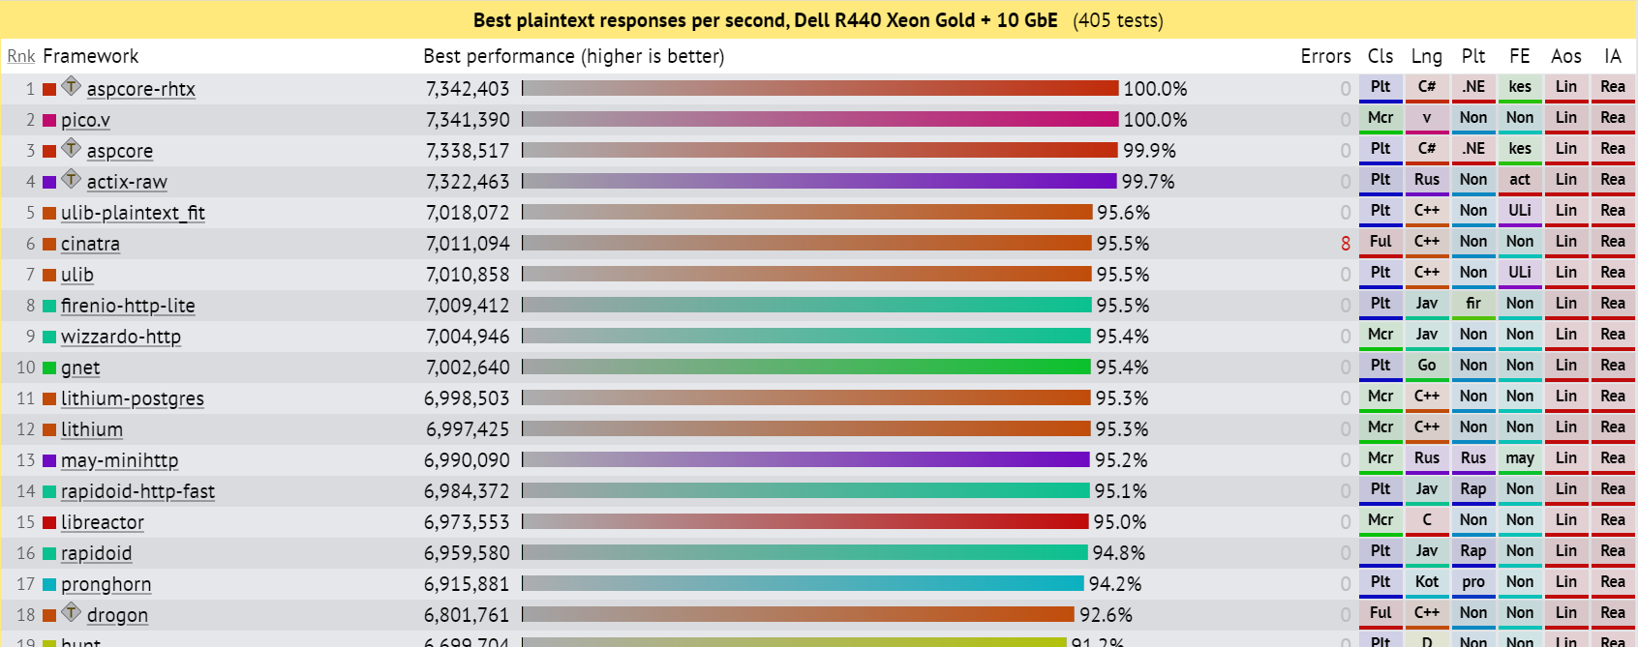
Performances
https://www.techempower.com/benchmarks

Slide 9
A new CLR
.NET Core comes with a new runtime for application execution called CoreCLR. It follows the same layout and architecture of .NET CLR and does things like loading the IL code, compiling to machine-level, and collecting garbage. However, the CoreCLR doesn’t support features that are too specific for the Windows platform or are proved to be unnecessary like application domains and code access security.
https://github.com/dotnet/runtime
Notes:
.NET Core comes with a new runtime called CoreCLR.
At the beginning there were two different repositories for two main libraries:
CoreFX contained all the libraries that related to collections, I/O, string manipulation, reflection, security, and many more.
CoreCLR perform operations such as memory allocation, garbage collection, exception handling, type safety, thread management, and security.
After several issues like:
Difficulty sharing sources.
Consistency
Complications moving issues between repos.
These two libraries have been consolidated into one.
This new CLR follows the same architecture as the prior, however, because of its cross-platform nature many features that were specialized for the Windows platform have been removed.

Slide 10
Relationships
ASP.NET Core run on both .NET Core and .NET Framework
ASP.NET Core
ASP.NET
ASP.NET MVC
Web framework
.NET Core
.NET Framework
.NET implementation
Windows
Linux
macOS
Windows
Operative system
Notes:
Starting with ASP.NET Core 2.1 Microsoft stopped supporting ASP.NET Core on .NET Framework.
However, ASP.NET Core 2.1 LTS will enjoy the same indefinite level of support as the rest of the .NET Framework.

Slide 11

One library to rule them all
.NET Framework
.NET Core
Xamarin
ASP.NET
WPF
UWP
iOS
OS X
App
models
Windows Forms
ASP.NET Core
Android
Base
libraries
.NET standard library
Base class library
Core library
Mono class library
Common infrastructure
Compilers
Languages
Runtime components
Notes:
The .NET platform was originally forked to fit the needs of single platforms. Each implementation had its own base class libraries.
This lack of a unified class library made hard for developers to share code between multiple .NET implementations.
.NET standard solved the code sharing problem by defining a uniform set of Base Class Libraries (BCL) available to all .NET implementations independent of the workload.

Slide 12
The kestrel
Be default, every ASP.NET Core application has Kestrel as built-in web server which is responsible for receiving raw requests and constructing an internal representation of the data. The resulting HttpContext object will then be available to the rest of the application.
https://github.com/aspnet/KestrelHttpServer
Notes:
Kestrel is open-source, event-driven, asynchronous I/O based server which is based on the same Libuv library as node.js.
It was launched by Microsoft along with ASP.NET Core and its used by default to host ASP.NET applications on any platform.
It allows ASP.NET Core applications to easily run on servers that relied on reverse proxies other than IIS like Nginx and Apache, without the need to address variations on the the startup configurations. By using Kestrel as an in-process server, applications will have a consistent startup process:
Main()
Startup.ConfigireServices()
Startup.Configure()

Slide 13
Different hosting models
A request is sent to IIS
Request
ASP.NET application
IIS calls into specific methods in the ASP.NET application
Application_BeginRequest() {...} Application_AuthenticateRequest() {...} Application_AuthorizeRequest() {...}
Application_ProcessRequest() {...}
Application_EndRequest() {...}
Application_HandleError() {...}
IIS
The control is transferred back and forth between IIS and the ASP.NET application as events are raised
Response

Slide 14
Different hosting models
A request is sent to IIS/Nginx/Apache
Kestrel processes the incoming request and passes it to the rest of the application
Request
ASP.NET Core application
IIS/Nginx/Apache passes raw request to kestrel web server
ASP.NET Core kestrel web server
IIS
Apache
Nginx
Application handles request and generate response
The response is sent to IIS/Nginx/Apache
Response

Slide 15



HTTP web request and reverse proxy
The request is processed by the application which generates a response
The reverse proxy receives the request and forwards it to the right web server
The browser resolves the URL and sends an HTTP request to a specific server
A user requests a web page with a URL
Web server
The response is passed back to the reverse proxy
Internet
Client
The HTTP response is sent to the browser
Reverse
proxy
Web server
Notes:
Because the only component exposed to the internet is the reverse-proxy, the underlining web servers are hidden to the client. This results in an improvement of the security and performances as well as decoupling the application from the underlining operative system.

Slide 16
Middleware
The response passes through the middleware back to the web server where it will be sent to the client
The ASP.NET Core web server receives the HTTP request from IIS/Apache/Nginx and passes it to the middleware
ASP.NET Core application
kestrel web server
Logging middleware
The middleware processes the request and passes it on the MVC middleware
Middleware pipeline
Identity middleware
The MVC middleware generates an HTML response
MVC Middleware
Custom middleware
Notes:
It is important to understand that Middleware can only use objects that are created by previous middleware in the pipeline. For example, you can perform authorization only after the authorization middleware.

Slide 17
Demo

Slide 18
Demo
Demos are available here: https://github.com/GTRekter/Sessions

Slide 19
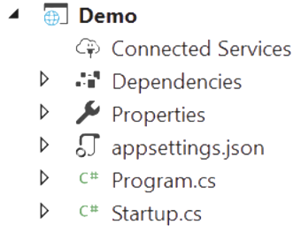
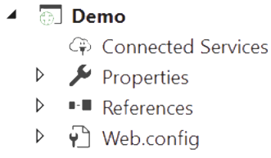
Project structure
ASP.NET Core application
ASP.NET application
Notes:
No matter what project type you choose, a .NET Core application will always start from the same entry point, a Main method in the program.cs file.
In fact, an .NET Core application is nothing more than a console application launched by the dotnet driver tool.

Slide 20
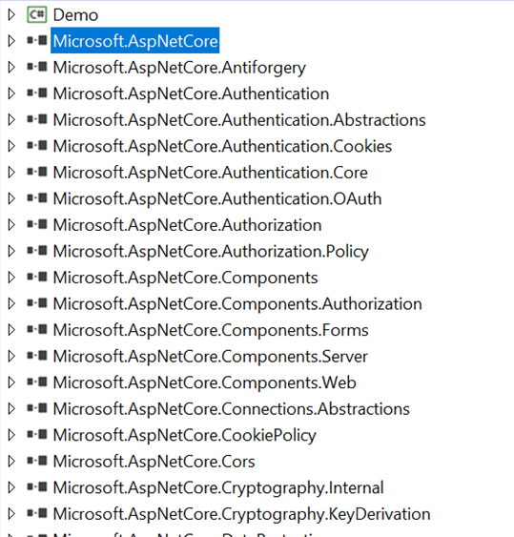
Dependencies
Instead of having to reference each individual ASP.NET package. By default, an ASP.NET Core application references a single NuGet metapackage called Microsoft.AspNetCore.App which references other NuGet packages.
https://www.nuget.org/packages/Microsoft.AspNetCore.App/
Notes:
With .NET Core, all framework and third-party libraries can be added to our project as NuGet packages.
Problem
With large sized applications that refer many libraries, adding each library one by one is a cumbersome process.
.NET Core 2.0 has simplified the packaging mechanism and has introduced meta-packages that can be added as one single package and contains all the assemblies that are linked to it.
For example, if you wanted to work on ASP.NET Core in .NET Core 2.0, you just have to add one single package, Microsoft.AspNetCore.All, using NuGet.

Slide 21
Two Deployment Modes
A .NET Core application can be deployed in two different ways:
Self-Contained: The application will include all the needed assemblies so it can run on a machine that doesn’t have the .NET Core SDK installed.
Framework-dependent: The target machine needs to have .NET Core SDK installed in order to run the application.
Notes:
What are the benefits of these two deployment methods?
Pros of a self-contained deployment
Control the exact version of .NET Core used at runtime.
Increase reliability by controlling when to upgrade each individual application.
Upgrade different applications at different times.
Pros of a framework-dependent deployment
Smaller size of the deployment
Lower disk and memory usage
Get security patches, and bug fixes by later releases without recompiling and republishing the application.

Slide 22
Demo
Notes:
.NET CLI provides a toolset with a handful commands that can be executed from the command line interface to create
To create a new project using .NET CLI, we can run the following command:
dotnet new
It will list all the available templates and the short name that can be used while creating new project.
Host.CreateDefaultBuilder(args)
Configures Kestrel server as the web server using the app's hosting configuration providers.
Sets the content root to the path returned by Directory.GetCurrentDirectory.
Loads host configuration from:
Environment variables prefixed with ASPNETCORE_ (for example, ASPNETCORE_ENVIRONMENT).
Command-line arguments.
Loads app configuration in the following order from:
appsettings.json.
appsettings.{Environment}.json.
Environment variables.
Command-line arguments.
Configures logging for console and debug output. Logging includes log filtering rules specified in a Logging configuration section of an appsettings.json or appsettings.{Environment}.json file.
When running behind IIS with the ASP.NET Core Module, CreateDefaultBuilder enables IIS Integration, which configures the app's base address and port. IIS Integration also configures the app to capture startup errors. For the IIS default options, see Host ASP.NET Core on Windows with IIS.
Sets ServiceProviderOptions.ValidateScopes to true if the app's environment is Development. For more information, see Scope validation.
For an HTTP workload, the Main method is the same but CreateHostBuilder calls ConfigureWebHostDefaults:
Loads host configuration from environment variables prefixed with ASPNETCORE_.
Sets Kestrel server as the web server and configures it using the app's hosting configuration providers. For the Kestrel server's default options, see Kestrel web server implementation in ASP.NET Core.
Adds Host Filtering middleware.
Adds Forwarded Headers middleware if ASPNETCORE_FORWARDEDHEADERS_ENABLED equals true.
Enables IIS integration.
ConfigureServices and Configure are called by the ASP.NET Core runtime when the app starts:
The ConfigureServices method is:
Optional.
Called by the host before the Configure method to configure the app's services.
Adding services to the service container makes them available within the app and in the Configure method. The services are resolved via dependency injection or from ApplicationServices.
The Configure method is used to specify how the app responds to HTTP requests.
POWERSHELL: dotnet publish -f netcoreapp3.1 –r ubuntu.14.04-x64
POWERSHELL: cat <FILE>
LINUX: type <FILE>
LINUX: ./WomanWhoCodeWeb

Slide 23
Demo
Demos are available here: https://github.com/GTRekter/Sessions

Slide 24
Q&A

Slide 25
Ivan Porta
Senior .NET Developer
@GTRekter

